Slide 1



INTERNSHIP 2023
Md Sabit Islam Bhuiya
at
Shellbeehaken Ltd.
Dhaka, Bangladesh

Slide 2
About Shellbeehaken Ltd.
Startup company established at 2020.
Product based company.
Currently focused on Japanese market.
Collaborated with Toyota, Sony, Fujitsu, Nagase etc.

Slide 3
What Shellbeehaken does
Web Development.
Desktop App Development.
Mobile App Development.
Enterprise Solutions.
Technical Consultancy.

Slide 4
My Internship Journey
INTERNSHIP
Training
Live Project Involvement

Slide 5
Phase 1 TRAINING Timeline: FEB - APR

Slide 6
February 2023 Training Phase: Basic Technology
Html
Css
Javascript
Git

Slide 7
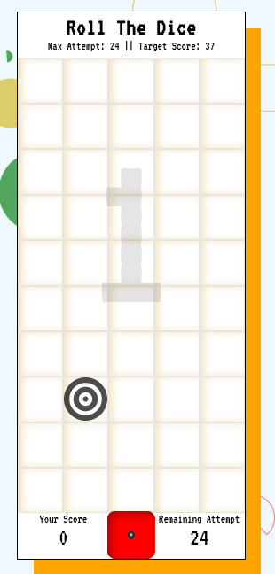
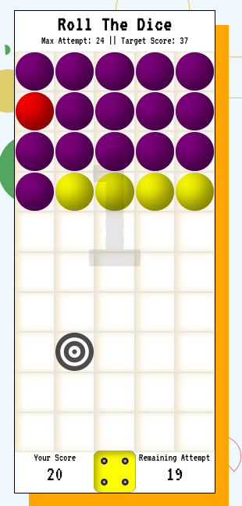
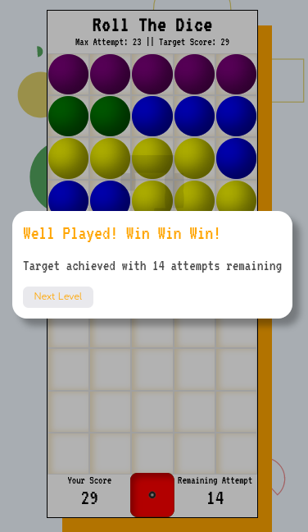
Training Phase: Game Project

Slide 8
March 2023 Training: Advanced Technologies and Concepts
React
Redux
Express
MongoDb
SCRUM
NextJs

Slide 9
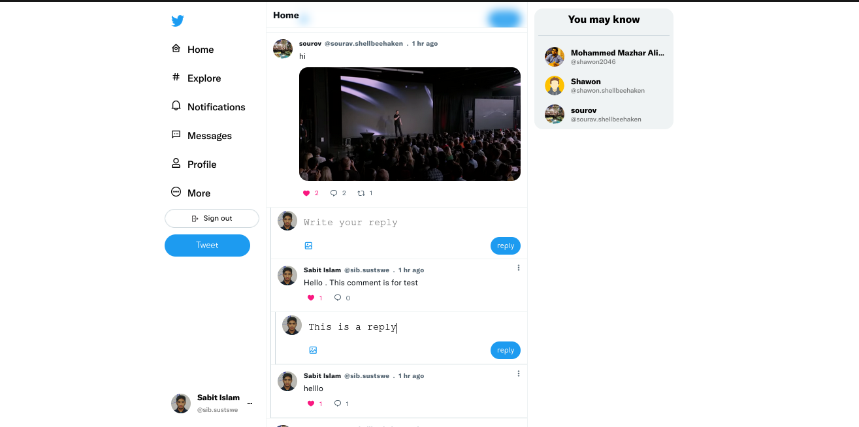
April 2023 Training: Advance Project
Twitter Clone.
A full stack social-network app

Slide 10
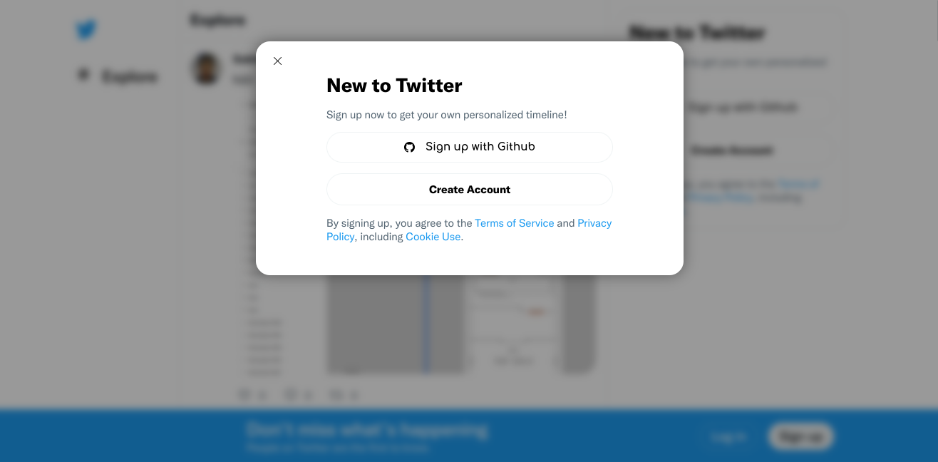
Twitter Clone
Authentication using github or email, password.
Email verification

Slide 11
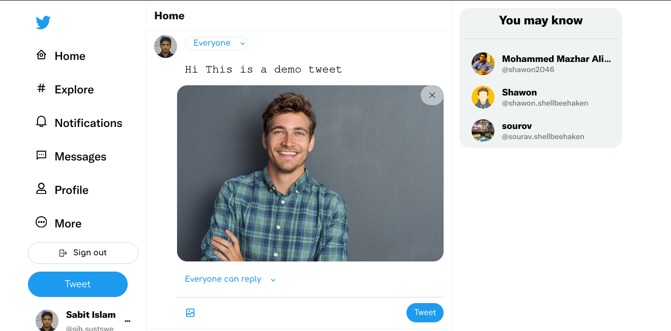
Twitter Clone
Create, delete or update tweets.

Slide 12
Twitter Clone
Like, comment or reply to comment.

Slide 13
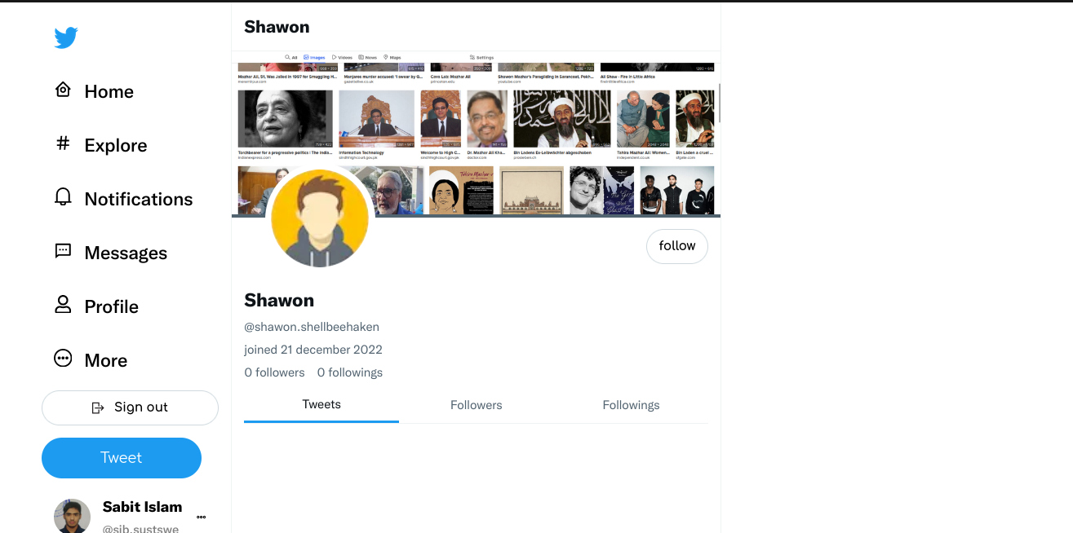
Twitter Clone
Follow or unfollow other users.

Slide 14
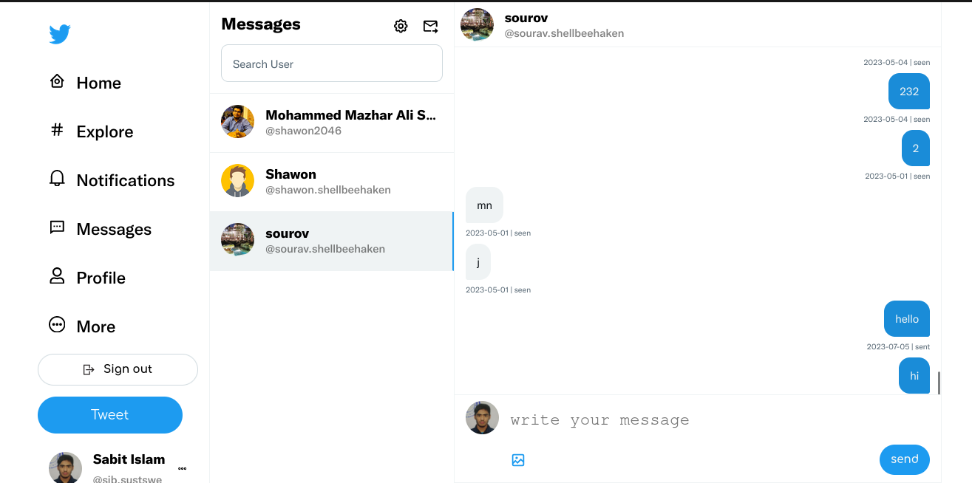
Twitter Clone
Search other users by name.
Real time messaging.
Real time message notification.

Slide 15
My Achievement From Twitter Clone
My Architectural Solution
Convention

Slide 16
Phase 2 LIVE PROJECT INVOLVEMENT Timeline: MAY - JULY

Slide 17
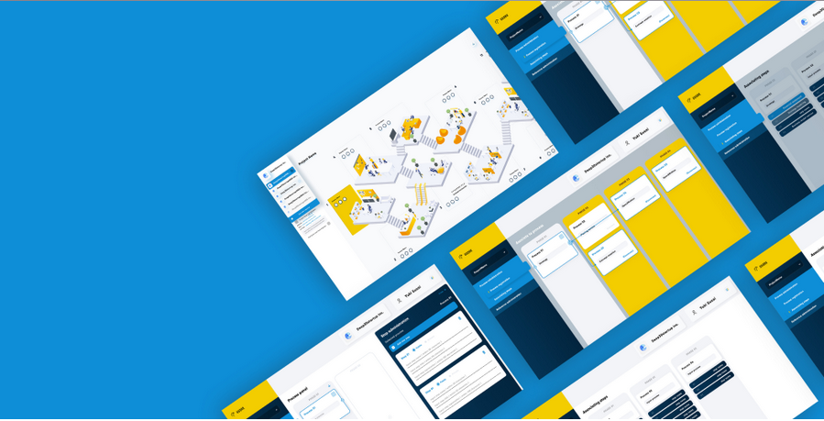
Project 1: UUORK
UUORK is a virtual company management software.
Members of a company can collaborate on UUORK.

Slide 18
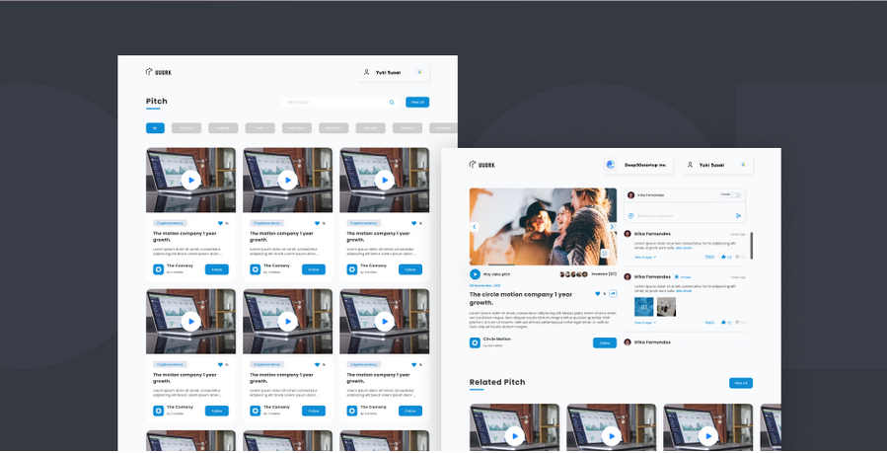
My Role in UUORK
Implemented both frontend and backend of a new module.
Fixed Several bugs from existing implementation.

Slide 19

Project 2: MAPAGE
MAPAGE is a saloon reservation software product in JAPAN.
MAPAGE has both mobile and web app.

Slide 20
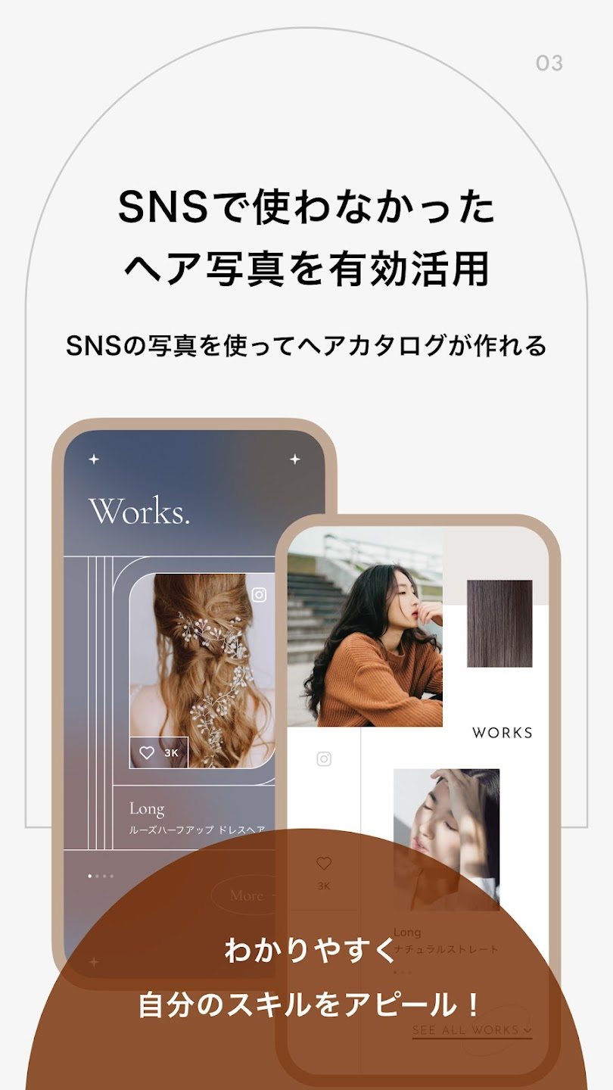
My Role in MAPAGE
Developed APIs for a new service.
Implemented front-end design and integrated with APIs.

Slide 21
Thank you

